Slide 1
BCSE309L : Cryptography & Network Security Project Review
Project Title : Man-in-the-Middle on Diffie-Hellman
Team Members :
Nikhil Parkar – 23BAI1199
Nischay Kuchibotla – 23BAI1245
Priyanshu Solanki – 23BAI1206

Slide 2
Problem Statement
Diffie-Hellman allows key agreement over insecure channels but is vulnerable to MITM without authentication. An attacker can intercept g^a and g^b, substitute own values, and share separate keys with Alice and Bob. In this project, simulate three parties (Alice, Bob, Attacker) using console messages (print exchanges). Implement basic DH from scratch. Show attacker intercepts and substitutes public values. Prevention: add RSA signatures to DH parameters for authenticity. Run 20–25 test cases with 100% MITM success before fix, 0% after signatures. Prove mathematically why unauthenticated DH allows substitution (no binding to identity) and how signatures prevent it. Use simple Tkinter GUI: Generate Parameters, Run Attack (MITM), Apply Prevention(signatures), Show Graphs + log showing message flow (red attacker arrows), secure status(green). Results in 4 mandatory graphs: success rate before/after, time vs key size, authentication rate, latency overhead.

Slide 3
Literature Review
Sr No. | Book Title | Author | Description
1. | Cryptography and Network Security: Principles and Practice (7th ed.). Pearson Education | W. Stallings | Stallings provides comprehensive coverage of the Diffie-Hellman protocol, MITM attacks, and countermeasures including ElGamal signatures and HMAC. The book presents these as a unified security framework where signatures provide authentication and HMAC ensures message integrity.
2. | Handbook of Applied Cryptography. CRC Press. | A. J. Menezes, P. C. van Oorschot, and S. A. Vanstone | This handbook formally defines the DH protocol, MITM attack scenarios, ElGamal signature scheme, and HMAC with rigorous mathematical proofs. It remains the definitive reference for researchers requiring complete algorithmic specifications and formal security definitions.
3. | Applied Cryptography: Protocols, Algorithms, and Source Code in C, 2nd ed. John Wiley & Sons, 1996. | B. Schneier, | Schneier explicitly warns about DH's MITM vulnerability and covers ElGamal signatures and keyed MAC constructs as practical defenses. His unique strength lies in illustrating real-world attack scenarios and why combining DH with signatures and MACs is essential.
4. | Understanding Cryptography: A Textbook for Students and Practitioners. Springer, 2010. | C. Paar and J. Pelzl | Paar and Pelzl provide step-by-step coverage of DH key exchange, SHA-256, HMAC, and ElGamal signatures within a unified mathematical narrative. The book naturally leads the reader from the DH MITM vulnerability to the cryptographic tools that resolve it.

Slide 4
Literature Review
Sr No. | Book Title | Author | Description
5. | Cryptography and Network Security. McGraw-Hill, 2007. | B. A. Forouzan | Forouzan explains the MITM attack on DH and covers SHA-256, HMAC, and ElGamal signatures as layered countermeasures within real protocols such as TLS and IPSec. His protocol-level perspective makes it ideal for understanding end-to-end MITM prevention in real systems.
6. | Introduction to Modern Cryptography, 3rd ed. CRC Press, 2020. | J. Katz and Y. Lindell | Katz and Lindell formalize the DH assumption, MITM attack, HMAC security, and ElGamal signatures through provable security theory and formal reductions. This textbook provides the strongest theoretical justification for why HMAC and ElGamal signatures are necessary and sufficient to prevent MITM attacks.
7. | Computer Security: Art and Science, 2nd ed. Addison-Wesley/Pearson, 2018. | M. Bishop | Bishop contextualizes MITM attacks within the Dolev-Yao threat model and presents SHA-256, HMAC, and ElGamal signatures as the principal cryptographic defenses. The book uniquely ties these tools to broader security architecture, key management policy, and certificate infrastructure.
8. | Network Security: Private Communication in a Public World, 2nd ed. Prentice Hall, 2002. | C. Kaufman, R. Perlman, and M. Speciner | This book walks through the MITM attack at the protocol message level and demonstrates how ElGamal signatures and HMAC-SHA256 close the vulnerability in real protocols like IKE and SSL/TLS. It is an essential reference for implementation-oriented research on MITM prevention.

Slide 5
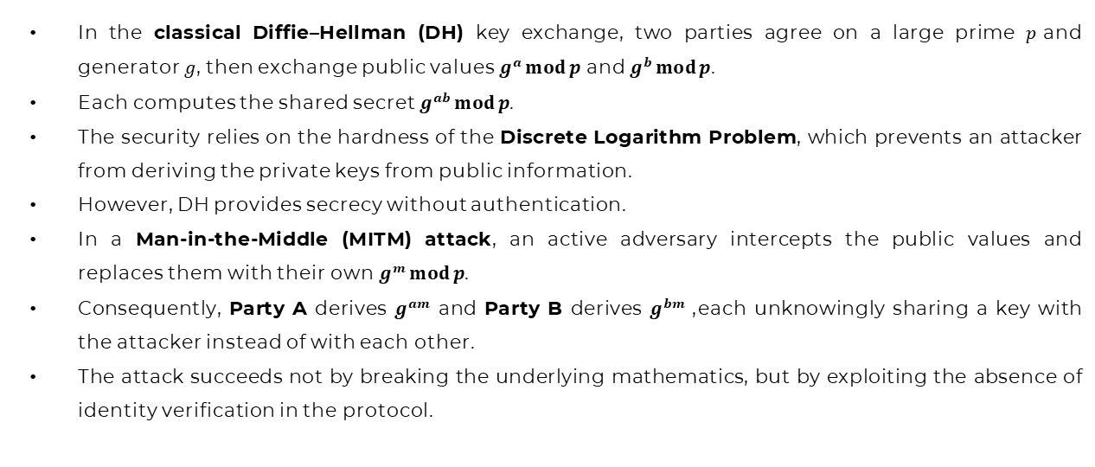
Mathematical Background
In the classical Diffie–Hellman (DH) key exchange, two parties agree on a large prime $p$and generator $g$, then exchange public values $g^{a} mod p$ and $g^{b} mod p$.
Each computes the shared secret $g^{ab} mod p$.
The security relies on the hardness of the Discrete Logarithm Problem, which prevents an attacker from deriving the private keys from public information.
However, DH provides secrecy without authentication.
In a Man-in-the-Middle (MITM) attack, an active adversary intercepts the public values and replaces them with their own $g^{m} mod p$.
Consequently, Party A derives $g^{am}$ and Party B derives $g^{bm}$, each unknowingly sharing a key with the attacker instead of with each other.
The attack succeeds not by breaking the underlying mathematics, but by exploiting the absence of identity verification in the protocol.

Slide 6
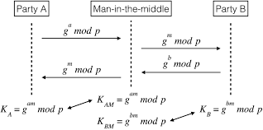
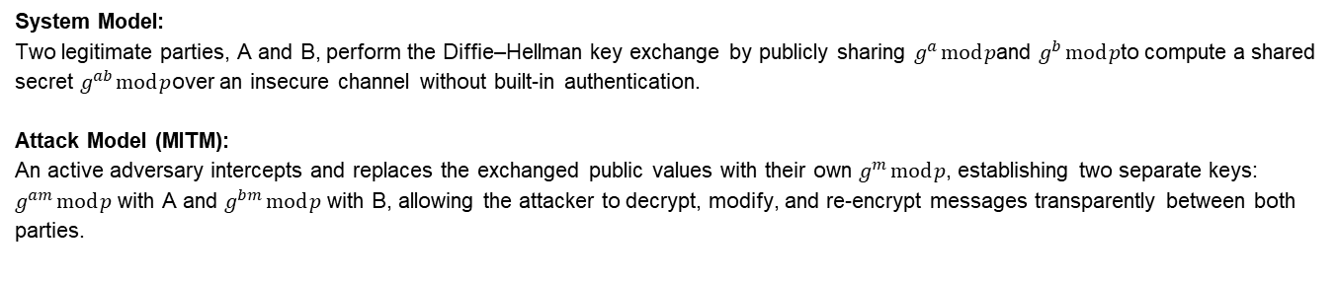
System & Attack Model
System Model: Two legitimate parties, A and B, perform the Diffie–Hellman key exchange by publicly sharing $g^{a} mod p$and $g^{b} mod p$to compute a shared secret $g^{ab} mod p$over an insecure channel without built-in authentication.
Attack Model (MITM): An active adversary intercepts and replaces the exchanged public values with their own $g^{m} mod p$, establishing two separate keys: $g^{am} mod p$ with A and $g^{bm} mod p$ with B, allowing the attacker to decrypt, modify, and re-encrypt messages transparently between both parties.

Slide 7
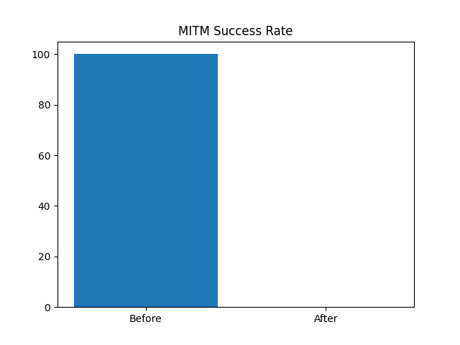
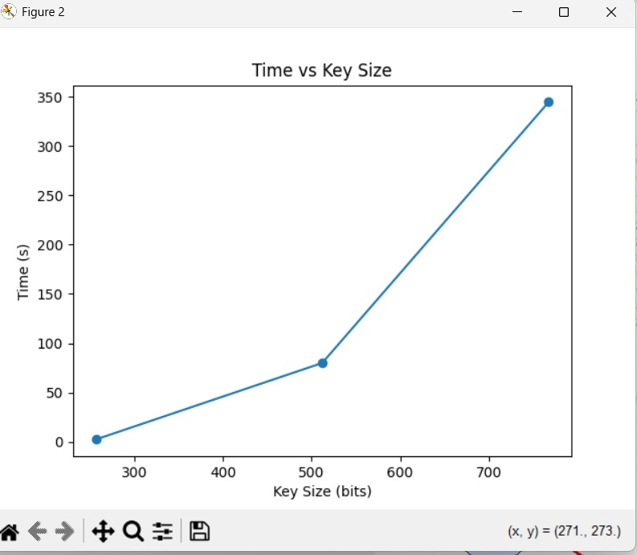
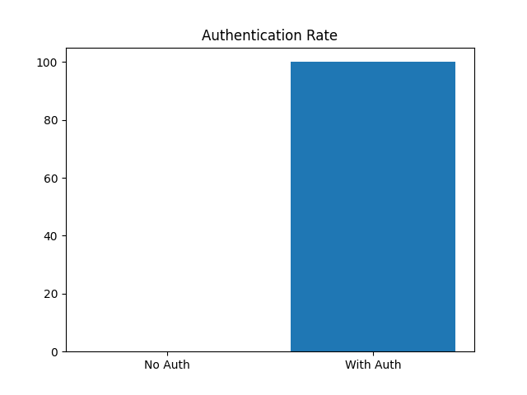
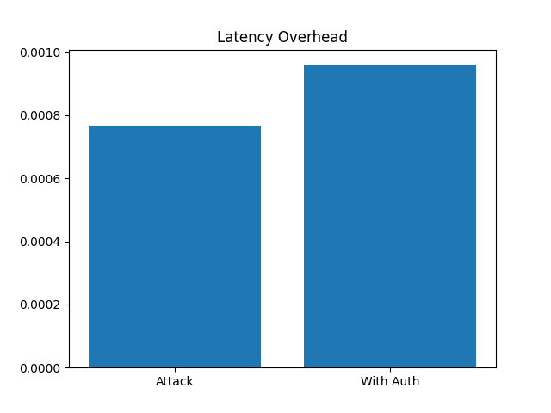
MITM Attack Results

Slide 8
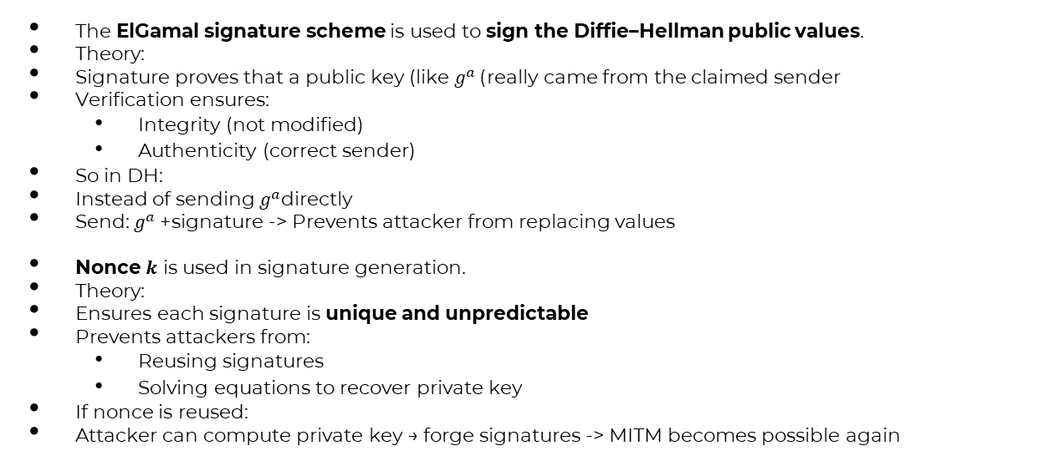
Attack Prevention Techniques (1)
The ElGamal signature scheme is used to sign the Diffie–Hellman public values.
Theory:
Signature proves that a public key (like $g^{a}$) really came from the claimed sender
Verification ensures:
Integrity (not modified)
Authenticity (correct sender)
So in DH:
Instead of sending $g^{a}$directly
Send: $g^{a}$+ signature -> Prevents attacker from replacing values
Nonce $k$ is used in signature generation.
Theory:
Ensures each signature is unique and unpredictable
Prevents attackers from:
Reusing signatures
Solving equations to recover private key
If nonce is reused:
Attacker can compute private key → forge signatures -> MITM becomes possible again

Slide 9
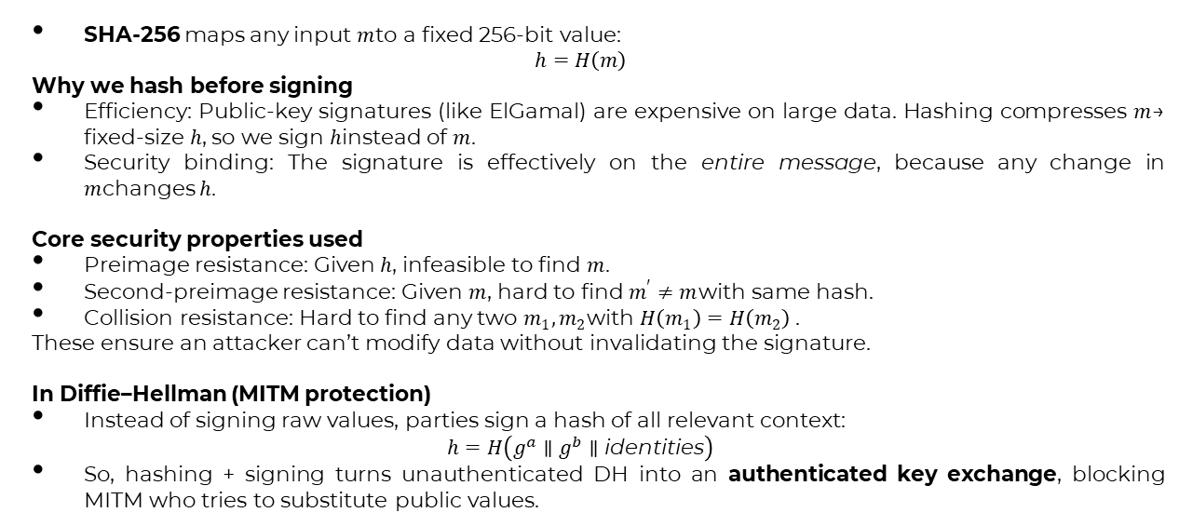
Attack Prevention Techniques (2)
SHA-256 maps any input $m$to a fixed 256-bit value:
$$h=H\left(m\right)$$
Why we hash before signing
Efficiency: Public-key signatures (like ElGamal) are expensive on large data. Hashing compresses $m$→ fixed-size $h$, so we sign $h$instead of $m$.
Security binding: The signature is effectively on the entire message, because any change in $m$changes $h$.
Core security properties used
Preimage resistance: Given $h$, infeasible to find $m$.
Second-preimage resistance: Given $m$, hard to find $m^{′}≠m$with same hash.
Collision resistance: Hard to find any two $m_{1},m_{2}$with $H\left(m_{1}\right)=H\left(m_{2}\right)$.
These ensure an attacker can’t modify data without invalidating the signature.
In Diffie–Hellman (MITM protection)
Instead of signing raw values, parties sign a hash of all relevant context:
$$h=H\left(g^{a}∥g^{b}∥\text{identities}\right)$$
So, hashing + signing turns unauthenticated DH into an authenticated key exchange, blocking MITM who tries to substitute public values.

Slide 10
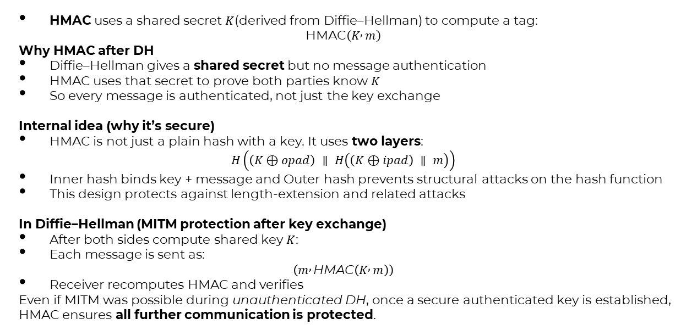
Attack Prevention Techniques (3)
HMAC uses a shared secret $K$(derived from Diffie–Hellman) to compute a tag:
$$\text{HMAC}\left(K , m\right)$$
Why HMAC after DH
Diffie–Hellman gives a shared secret but no message authentication
HMAC uses that secret to prove both parties know $K$
So every message is authenticated, not just the key exchange
Internal idea (why it’s secure)
HMAC is not just a plain hash with a key. It uses two layers:
$$H\left(\left(K⊕opad\right) ∥ H\left(\left(K⊕ipad\right) ∥ m\right)\right)$$
Inner hash binds key + message and Outer hash prevents structural attacks on the hash function
This design protects against length-extension and related attacks
In Diffie–Hellman (MITM protection after key exchange)
After both sides compute shared key $K$:
Each message is sent as:
$$\left(m , \text{HMAC}\left(K , m\right)\right)$$
Receiver recomputes HMAC and verifies
Even if MITM was possible during unauthenticated DH, once a secure authenticated key is established, HMAC ensures all further communication is protected.

Slide 11
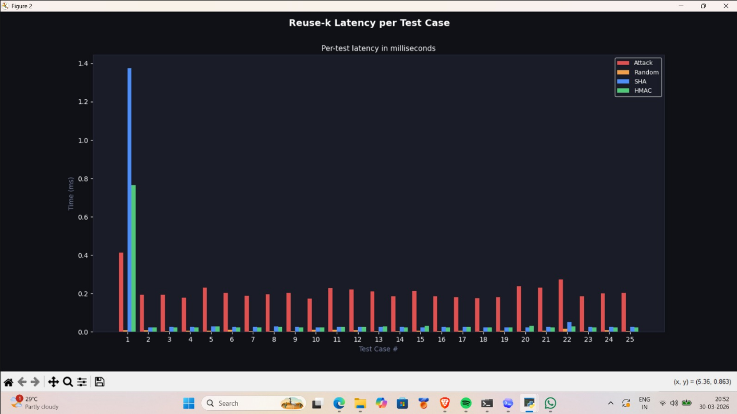
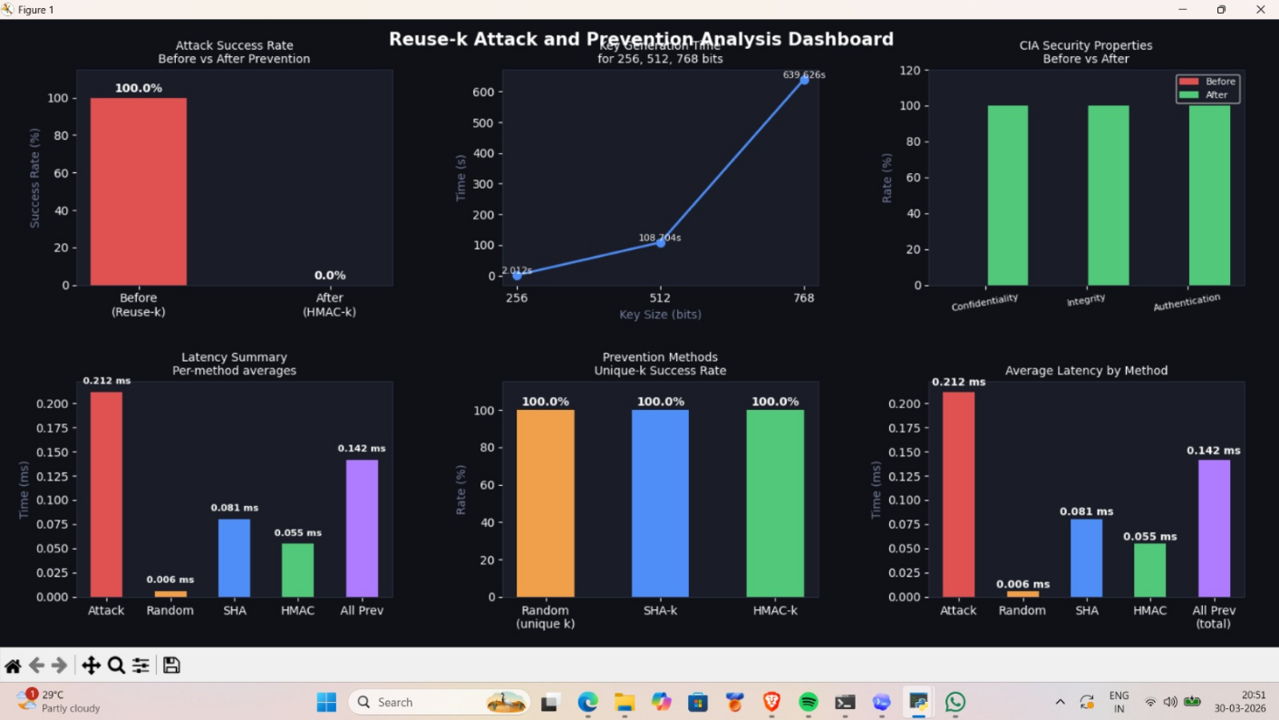
Results
Reuse-k (nonce reuse) means using the same random value $k$in multiple ElGamal operations; since $k$ appears in both $r=g^{k} mod p$ and $s=k^{−1}\left(m−xr\right)$ reusing it makes the equations for different messages share the same unknown, linking them algebraically.

Slide 12
Thank You!

